Slide 1
STRATHCONA COMMUNITY HEALTH HUB

Slide 2
Tonight, we will…
Have good conversations.
Answer questions you may have to the best of our ability.
Address identified gaps in the GNC from our last conversation.
Provide an update on our GNC.
Take away feedback to refine the GNC.

Slide 3
What the GoA has Committed
More than $124 million over two years towards Alberta’s recovery-oriented system of care
Hybrid health and police hubs – $28 million in capital and operating funding over two years, starting this year
Medical detox – $11 million in capital and operating funding
Harm reduction and recovery outreach teams – $8 million in operating funding over two years.
Notes:
Last engagement people were concerned about what new services would be in the area and where we would refer people. will focus on increasing access to addiction and mental health services in Edmonton and Calgary.
We are already seeing the impact on these in the community with more treatment and detox beds for inner city agencies.

Slide 4
Edmonton Public Safety and Community Response Task Force.
The initiatives the task force is responsible for implementing will help provide more life-saving services to Edmontonians struggling with addiction and homelessness while enhancing public safety within the city. This work will include:
further increasing addiction treatment capacity in Edmonton
providing addiction and mental health treatment programs in correctional centres
creating a hybrid health and police hub
expanding medical detox services
building harm reduction and recovery outreach teams
expanding access to emergency shelter space
Notes:
The task force will implement a series of initiatives in the Edmonton metropolitan region as part of a $187-million commitment to address addiction and homelessness in Alberta’s urban centres. In Edmonton, $63 million of this funding will go toward dramatically increasing access to addiction services and supports over the next two years, and $19 million has been allocated to combat homelessness.

Slide 5
OPS Application Process
Each site is considered on a case-by-case basis, on its own merits. The GoA takes the information in the application and public and health safety objectives into account.
The application must meet the requirements for service providers respecting policies, procedures, protocols and records, as set out in the Mental Health Services Protection Act (MHSPA), Mental Health Services Protection Regulation and the Recovery-oriented Overdose Prevention Services Guide.
Description of proposed site
Description of local conditions
Policies and procedures
Consultation report
Personnel
Roles and responsibilities of staff members and their training requirements
Financial plan
Notes:
Proposed services to be offered at the site ,Proposed hours of operation, Description of the flow of the site, Mandatory overdose prevention and recovery
services
Description of target client population, Number of drug-related overdoses and deaths in local area, Intended health and safety impact of site on target population, general public and local area
Confirmation that policies are in place, Description of records maintained at site:
Staff training log
Client or visitor entry and exit log
Security measures taken to minimize risks
implemented written policies that demonstrate clearly defined referral pathways to recovery-oriented services and, where possible, minimize barriers to accessing detox and
treatment programs?
prepared and implemented written policies respecting physical safety and security measures for the location where you offer or provide services.
We require a criminal record check and resume for the responsible person in charge.
Professional designation and regulatory body licence number (if applicable)
Proposed schedule
The site is required to have a Responsible Person in Charge (RPIC). The RPIC is responsible for the site and activities at the site during operational hours. The RPIC is not required to be in the consumption area, but must be located within the same building and on the same floor as the SCS during operating hours.
Description of the financial plan and funding that will be in place

Slide 6
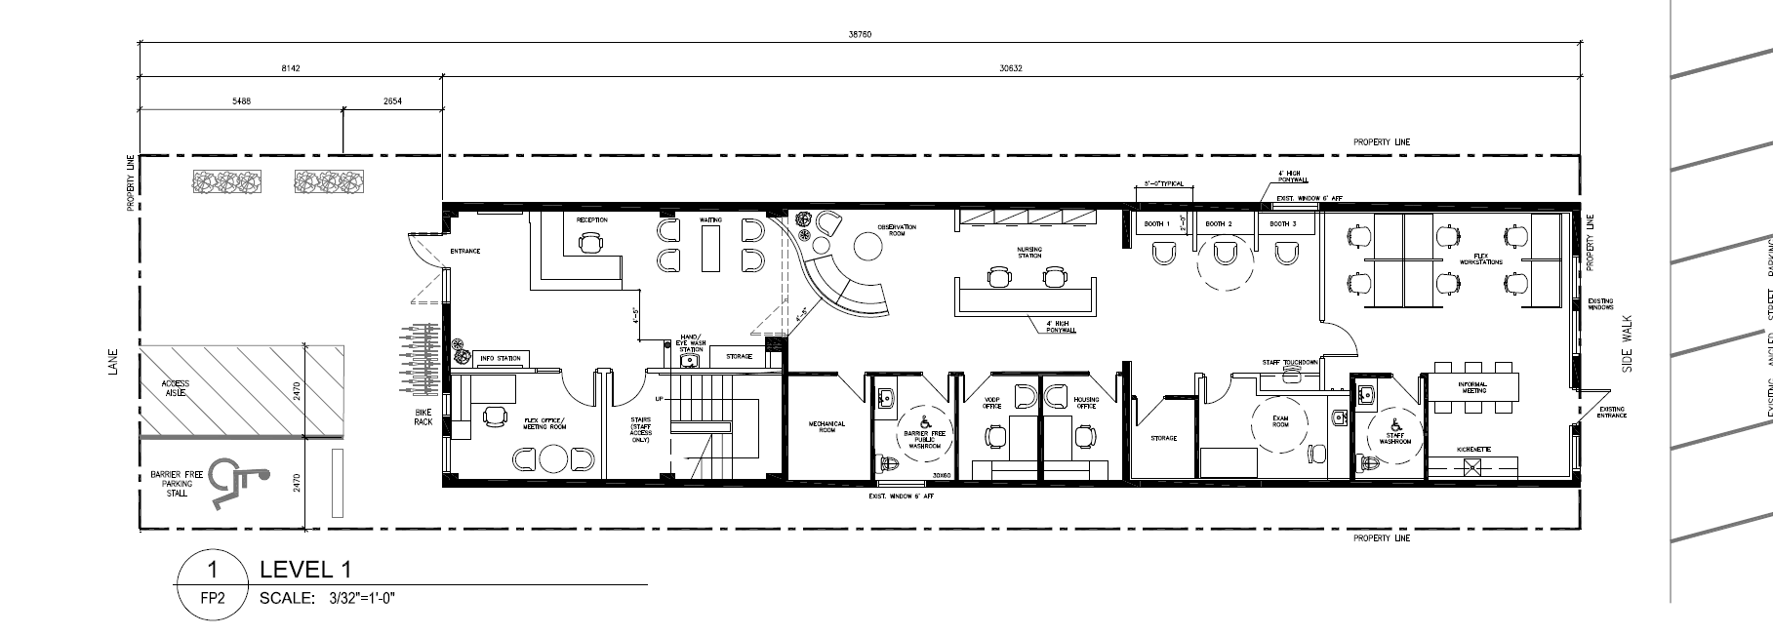
Potential Floor Plan and Flow of Site
Notes:
We heard last conversation back entry, since front door, what would you prefer

Slide 7
Front Street Entrance

Slide 8
Services Confirmed Onsite
Our daily operational staff of 2 nurses, social worker, community support worker, peer support worker will provide the following; ( also onsite - team lead and security).
Overdose Prevention Service
Basic & Complex Wound Care (RN/LPN)
Daily Dispensing of Medication (RN/LPN)
Social Counselling and referrals
Trauma Counselling and referrals
Housing Supports & Information
Treatment and Recovery referrals
Primary Care referrals (Dr./NP/RN)
STBBI Education (RN/LPN)
Harm Reduction Support
Notes:
The daily on site staff will make appointments for housing or counselling, they will have access to the Virtual Opioid Dependency Program daily, and are trained to and have relationships with other agencies if a service user needs immediate attention such as wound care etc.

Slide 9
Services Confirmed Onsite
Housing First Worker/Housing Outreach worker – 2 days a week
Mental Health Counselling – 2 days a week
Physician or Nurse Practitioner – 1 day a week
BSCS Clean up Crew – 3 days a week
Intensive Community Engagement Worker – 5 days a week
Cultural Support – 1 day a week
Onsite Security during operational Hours
AHS Opioid Dependency Program Mobile Team
We will have a Community Action Team that will meet once a month
Notes:
In my discussions with TMS we have identified gaps in the community, some of those are a consistent person on site that will take on a case load for housing and mental health services, cultural support and immediate health care.

Slide 10
George Spady Medical Detox Pathway
Notes:
One example of the many services and partnerships,
Currently the GSS Detox prioritizes people who use the SCS/OPS services and we are in discussions with George Spady of doing direct satellite daily triage

Slide 11
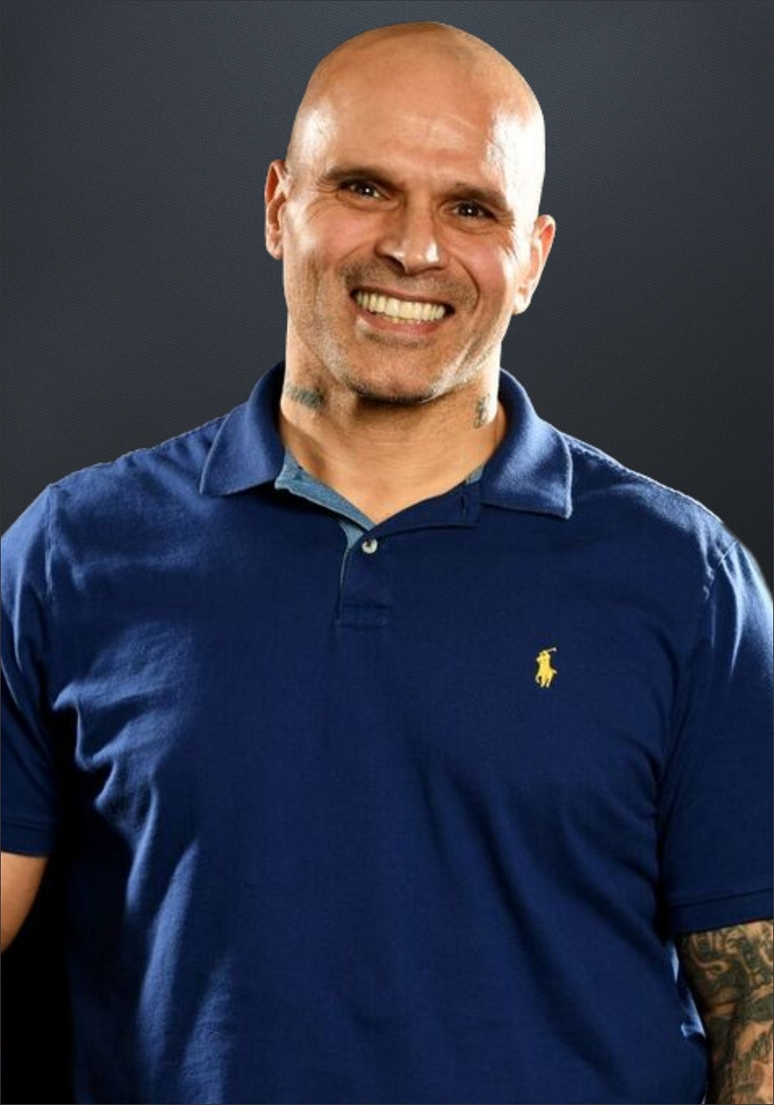
Guy spent 30 years in the repeated cycle of gangs, addiction, treatment and jail. He spent nearly 20 years residing in the two block radius in the Downtown Eastside and using many resources, including harm reduction, to keep himself alive. Guy Felicella spent three decades living in the grips of addiction and homelessness, surviving multiple life-threatening infections, several public health crises and six overdoses.
“I don’t support Harm Reduction over Recovery and I don’t support Recovery over Harm Reduction; I support people.” Guy Felicella
Courage To Come Back 2021 - Guy Felicella - Addiction Recipient - Bing video
Notes:
We heard from conversations people wanted success and how an OPS its positive I met Guy in 2003 when Insite first open their doors……….off the top

Slide 12
Who is here to answer questions;
BSCS – Good Neighbour Commitment
BSCS – Operations
BSCS – Services
Alberta Health – Licensing
Alberta Health Services – Accountability and reporting
Mom Stop the Harm – Lived Experience
EPS – Public Safety and Partnership
EDFRS – Calls for service in the area related to opioid poisoning

